Slide 1
Sometimes with One I Love
By: Jazmin Vital
- Walt Whitman

Slide 3
My Thoughts.
When I read the title, my first thought was he was going to talk about love and his desire for someone.
The comprehension of the poem wasn’t hard, and I could understand the point he was trying to get across
Words I had to look up were ardently and effuse
Ardently means very enthusiastically or passionately
Effuse means to talk in an unrestrained or excited manner
I had to reread sentences such as, “But now I think there is no unreturn’d love, the pay is certain one way or another”

Slide 4
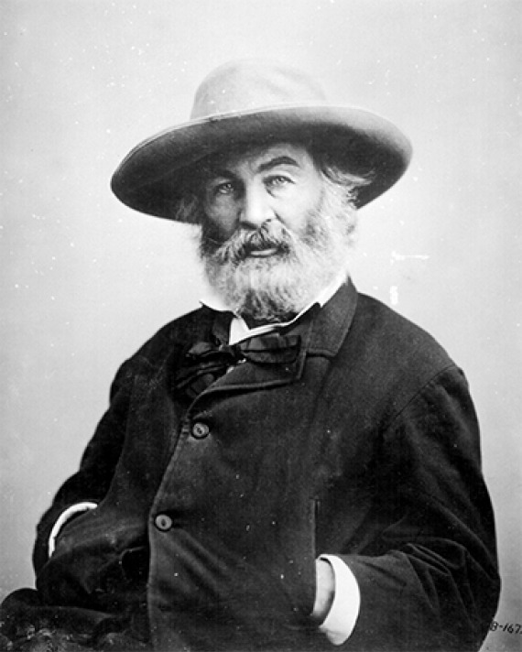
Summary
In the poem “Sometimes with One I Love” by American poet Walt Whitman he expresses that he loved, but he didn’t have the love in return. Walt also explains that without the love, anguish, and emotional disparity, there would be nothing to write about or express. As written, “I loved a certain person ardently and my love was not return’d, Yet out of that I have written these songs”

Slide 5
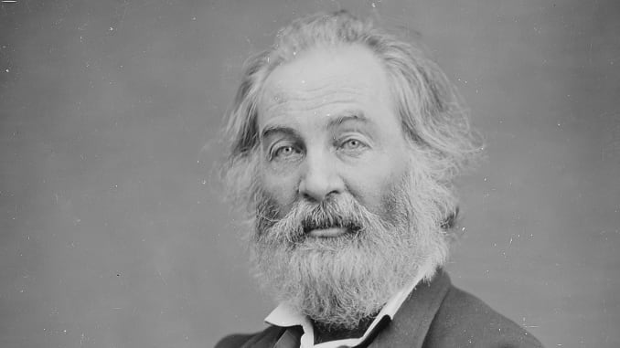
Poetic Devices
Free Verse
This poem is a free verse because there is no rhythm or regular meter. Whitman follows the rhythm of natural speech and lets his thoughts flow throughout the next sentence.
Anaphora
The anaphora in the text is "unreturn'd." It's a word or phrase used repeatedly within a speech or text to add effect, especially in the beginning.
Mood
Whitman sets the mood from the begging talking about the range and fear of not receiving love. He creates an emotional setting that surround the readers.
Epistrophe​
The epistrophe in the poem is love because it is repeats itself at the end of a phrase, clause, verse, or sentence.
Literal language
"Sometimes with one I love I fill myself with rage for fear I effuse unreturn’d love." Literal language means exactly what it says.

Slide 6
Time Period
Walt Whitman's "Sometimes with One I Love" comes from a cluster of poems in Leaves of Grass written by Walt. Whitman writes that the poems were partially important in his purpose to achieve "emotional expressions for humanity."

