Slide 1
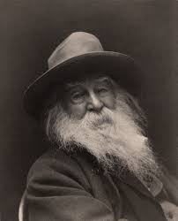
Walt Whitman "I Hear America Singing"
Blake Torrey

Slide 2
Making Sense
The only way I can make this poem relate back to Whitman is knowing from what I've read about him. Knowing he has struggled in his career, this poem is unifying those who have laborious jobs who don’t get recognized as well as they should.

Slide 3
Judging by the cover
Just from reading the title of the poem, "I Hear America Singing", I quickly assume that the poem will somewhat reference Americans singing literally, or metaphorically.

Slide 4
Thoughts on Poem
After reading the poem, I immediately went back to my inference before reading it regarding Americans singing in a literal or metaphorical manner because I thought that fit perfectly. Essentially, the title is straightforward with being intact with the poem itself. I thought the rhythm or meter was off, or not even there, but after reading about Whitman's writing style, it made sense. This poem was a short free verse. The poem wasn’t necessarily about America singing itself. "America" was referencing American people, who specifically had hard working conditions, labor, or roles that didn't receive much recognition as a career. He refers anywhere from "carpenter" to "washerwomen." Giving the spotlight to women whereas of that point in time, they couldn’t vote yet. When reading the poem you can tell he is trying to bring a joyous unification to hard working Americans.

Slide 5
Researching concepts
This poem was short and simple, finding out certain ideas and concepts were all thanks to Shmoop, a literature site that helps you analyze certain works of literature. Sometimes even giving you videos to aid you in understanding an author's work. The only concept I had to research was Whitman's meaning of singing. Singing is in fact a literal act of a celebration unifying the hard-working Americans. I previously had thought it was a metaphorical meaning, but Whitman says "The day what belongs to the day" meaning daytime is meant for the work. Then he says "at night the party of young fellows. Robust, friendly, singing with open mouths their strong melodious songs," meaning when dusk pasts, they're all singing their "melodious songs."

Slide 6
Summary
"I Hear America Singing" is simply about American people who have laborious careers putting in the work in the daytime, and at nighttime, all celebrating and unifying those who have those jobs by singing songs. Whitman focuses on the backbone of America, like mechanics, shoemakers, mothers, and even seamstresses.

Slide 7
Anaphora
Whitman uses anaphora throughout the poem, but not until the third line where he says, "The carpenter singing his as he measures his plank or beam." This is the start of Whitman using anaphora, starting off each sentence stating a given profession followed by them singing.

Slide 8
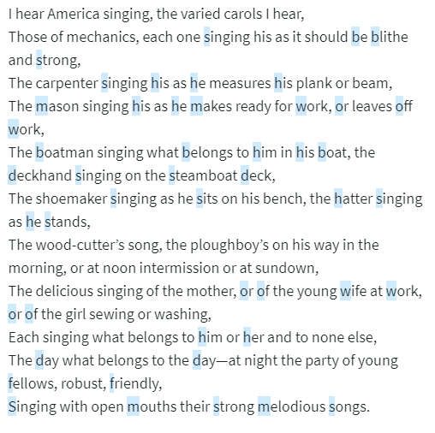
Alliteration
Whitman uses alliteration throughout the whole poem and is very easy to find and makes the poem flow smoothly as well.

Slide 9
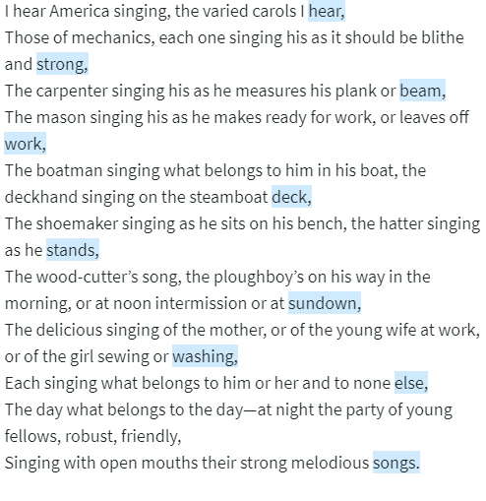
End-Stopped Line
Whitman uses commas very often in this poem for emphasizing the idea presented before the comma, which he puts in almost every line. It also gets you to stop and eventually, let every idea sink in and let the reader "connect the dots" essentially.

Slide 10
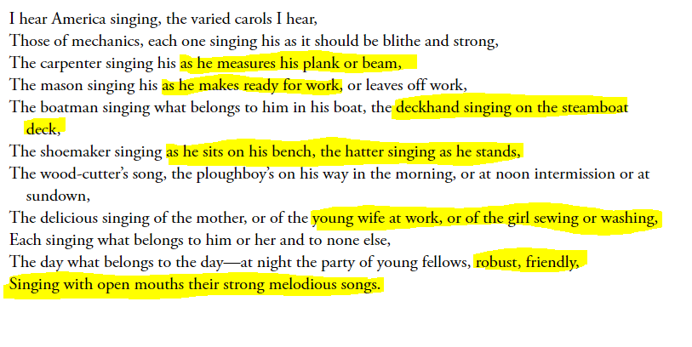
Imagery
Whitman uses imagery describing almost every person and their career, to get the reader to really catch on to who the author is targeting in this poem and why.

Slide 11
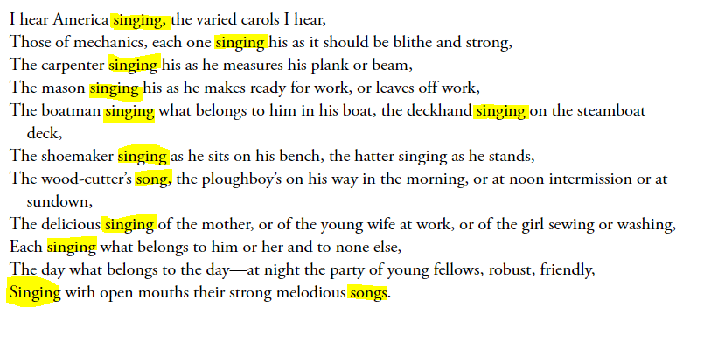
Repetition
Whitman's main artifact in this poem is getting through to the reader the picture of these American's singing. He gets that through simply by repeating the word singing, or songs in almost every line in the poem. Making it a main point of focus for the reader to look at and analyze.

