Slide 1
I Sing the Body Electric
By: Christian White

Slide 2
Poem Thoughts?
To begin with just the title, I thought the poem would have something to do with appreciating and taking care of the body. I thought it would involve having much self-love and treating yourself with the upmost respect.
Words Researched:
Balks account- to stop at an obstacle
Limpid: free of anything that darkens
Partition: to divide into parts
Figuring it out:
To analyze Whitman’s longest and most specific poem, I had to break the poem down line by line. To understand the message it was trying to convey, I read slowly and had to realize what each word meant individually, and then what they meant in the grouping of sentences.

Slide 3
Summary
Throughout the whole poem, Whitman celebrates the natural beauty of both the male and female body. Section 1 describes how the body has a very special link to the soul and how evil can infiltrate the body and ruin the beauty of it. Section 2 expresses how the bodies of every male and female are flawless and how they’re beauty can’t matched. He then goes on to describes the perfect gestures of all people like swimmers, babies, and laborers. In the third section describes a farmer he once knew that was very beautiful and could have anyone he wanted. The fourth section elaborates on how being around people that are “beautiful and curious” is good for the soul. Section 5 is about the women’s beautiful body but, very sexually explicit as it goes into detail about various sexual acts. It also explains how her body is beautiful because it can bare a child ad create generations. Section 6 is about males and how they much power and pride. This sections also explains how both genders have their important positions and how they should be equal. Sections 7 & 8 are describing slave’s bodies at an auction. He then goes back into how everyone should be equal. The last sections describes the many parts of the body and their functions and also comes to the conclusion that the body and soul are one unit and they can’t function without one another.

Slide 4
Poetic Devices
Free Verse: This poem is free verse because the poem has no rhythm or rhyming words. Whitman continues his thoughts in the next sentence instead of rhyming them.
Metaphors: Whitman uses metaphors to describe people in greater detail. Ex. “To see pass conveys as much as the best poem.” Here he compares this man’s walk to reading a good poem.
Imagery: Throughout the whole poem, there are many examples of imagery in the way Whitman describes people and their bodies. Ex. “The group of laborers seated at noon-time with their open dinner-kettles.”
Anaphora: Whitman uses this effect to show that the details of what he’s describing are important to his piece. Ex. “She is in her place and moves with perfect balance, She is all things duly veil’d, she is both passive and active, She is to conceive daughters as well as sons, and sons as well as daughters.”
Repetition: This is used to show that Whitman’s message is of importance and remembered. Ex. “Soul”, “Love”, “Body”

Slide 5
Time Period
“I Sing the Body Electric” discusses themes of men and women being equal, getting to know yourself physically, and being in touch with your sexuality. All of these topics were taboo or simply not up for discussion. With Whitman writing about them it caused and uproar of responses, positive and negative, but this got people to talk. I feel that this was the start of some major revolutions like, Women Suffrage and Body Positivity. When people started to have the mindset that everyone was equal, this paved the way for everyone to have the same opportunities and dreams without any obstacle standing in their way.

Slide 6
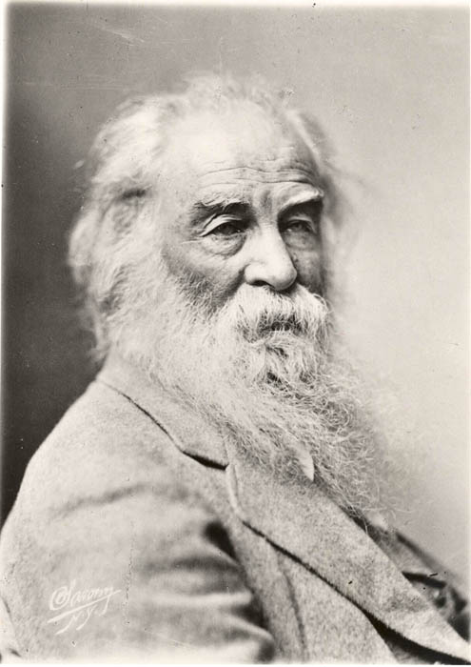
I Sing the Body Electric
https://www.poetryfoundation.org/poems/45472/i-sing-the-body-electric

