Slide 1
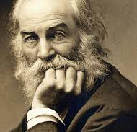
I Hear America Singing
Poem by Walt Whitman

Slide 2
The poem itself
I hear America singing, the varied carols I hear,
Those of mechanics, each one singing his as it should be blithe and strong,
The carpenter singing his as he measures his plank or beam,
The mason singing his as he makes ready for work, or leaves off work,
The boatman singing what belongs to him in his boat, the deckhand singing on the steamboat deck,
The shoemaker singing as he sits on his bench, the hatter singing as he stands,
The wood-cutter’s song, the ploughboy’s on his way in the morning, or at noon intermission or at sundown,
The delicious singing of the mother, or of the young wife at work, or of the girl sewing or washing,
Each singing what belongs to him or her and to none else,
The day what belongs to the day—at night the party of young fellows, robust, friendly,
Singing with open mouths their strong melodious songs.

Slide 3
Summary
The poem is about the various blue-collar workers of America. It describes the work of the seamstress, brick mason, boatman, lumberjack, mechanic and carpenter. They all sing about their work, despite it being time consuming and backbreaking, they all sing. The singing implies the people love doing it because it's honest and it pays the bills. I believe it's also a testament to how Americans are hard working in general. Who else would be doing hard work, enjoying themselves and not complaining but a hard-working person?

Slide 4
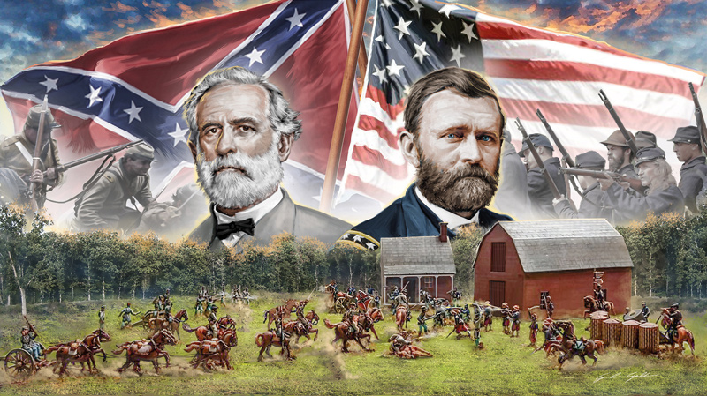
Context
The context for this poem is a few years before the American Civil war. A time where America couldn't have been more divided. So why a poem about unity? I believe that he wrote this poem to say "despite America's divided state, we're all still American, we all call this land home, and work hard for a living." He wrote it to relieve the tension looming over all of America at the time.

Slide 5
Poetic devices
Written in the free verse style, no identifiable style, rhyme, or rhythm.
Alliteration: In line 6 "The shoemaker singing as he sits on his bench, the hatter singing as he stands"
Cheerful diction: Uses singing to describe hardworking, happy Americans.
Personification: He compares America to the worker's singing, giving America a human aspect.
Repetition: He repeats the word singing for every worker in the poem and how they all sing their own song.

Slide 6
Thought the process
I started to think about what the poem meant. The fact that everyone is singing doing something difficult must mean that they're enjoying themselves somehow, or they found joy in something to distract themselves from the work. I chose the former because it implies optimism. The ladder implies pessimism, but I couldn't find anything else that supports a pessimistic viewpoint.
I was confused as to what line 9 meant as the fact everyone is singing implies unity, but then this curve-ball comes and says "what belongs to him and her and no one else" which implies individuality. So I was confused, but I realized that it also implies unity because it's a trait that all the blue-collar workers share, they work for what's theirs and they get to use it how they see fit.

